Slide 1

YUSAK SETIAWAN

Slide 2
01. Setup (Install Ruby)
Installing ruby on your box.
Windows: download the installer from https://rubyinstaller.org/downloads/
(choose with devkit installer)
Mac : type brew install ruby on your terminal
Check your installation
Windows: C:\> rails –v
Mac : ruby -v

Slide 3
02. Setup (Install Jekyll)
After you succeded installing ruby, then you can open your terimina / command prompt, and type
Windows
C:\>gem install jekyll bundler
Mac
gem install –user-install bundler jekyll

Slide 4
03. Clone Horee Site
In order to maintain horee.org site, you should clone it first to your local.
git clone https://github.com/horeeorg/horeeorg.github.io.git
Then go to your terminal / command prompt and then to build and serve the site locally
jekyll build
jekyll serve

Slide 5
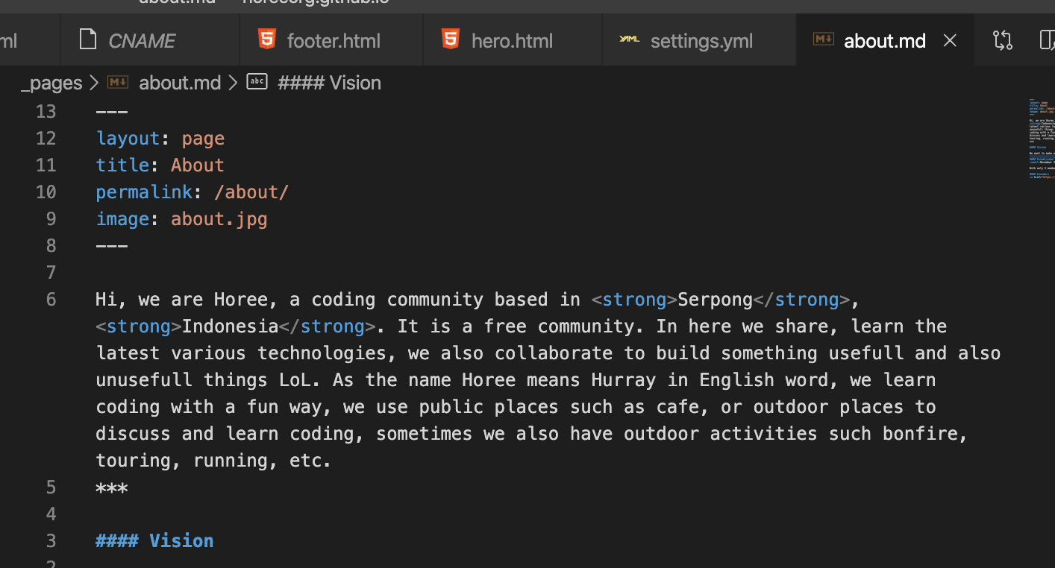
04. Jekyll Intro
_config.yml
This is where Jekyll configuration to build your site.
Front matter
On the top of the file, to configure the page.

Slide 6
05. Create Post
Put your file in folder _post
Name your post file using this format YYYY-MM-DD-name-of-post.markdown
Include necessary front matter
Follow the documentation to create
Image
Code Snippet
Font Header
Etc
Ref: https://www.creativebloq.com/how-to/jekyll-blog

